Slide 1


DS501 Statistical and Mathematical methods for Data Science
Lecture Week 10
Linear Algebra for DS
Certified Data Analyst [KARACHI.AI]

Slide 2
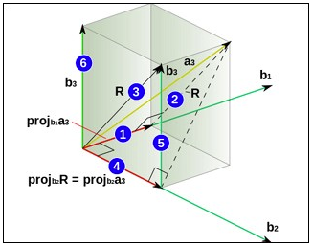
Linear algebra for Data science
What is Linear Algebra?
Linear algebra is the branch of mathematics concerning linear equations, linear functions and their representations through matrices and vector spaces.
Algebra is the branch that deals with linear equations and linear functions which are represented through matrices and vectors.
In simpler words, it helps us understand geometric terms such as planes, in higher dimensions, and perform mathematical operations on them.

Slide 3
Linear algebra for Data science
By definition, algebra deals primarily with scalars (one-dimensional entities), but Linear Algebra has vectors and matrices (entities which possess two or more dimensional components) to deal with linear equations and functions.
Why Linear Algebra is significant in Data Science?
Linear Algebra is central to almost all areas of mathematics like geometry and functional analysis.
Its concepts are a crucial prerequisite for understanding the theory behind Data Science.

Slide 4
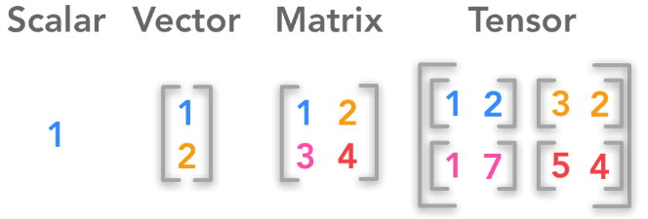
Linear algebra for Data science
How Linear Algebra is used in Data Science?
Scalars, Vectors, Matrices and Tensors
A scalar is a single number
A vector is an array of numbers.
A matrix is a 2-D array
A tensor is a n-dimensional array with n>2

Slide 5
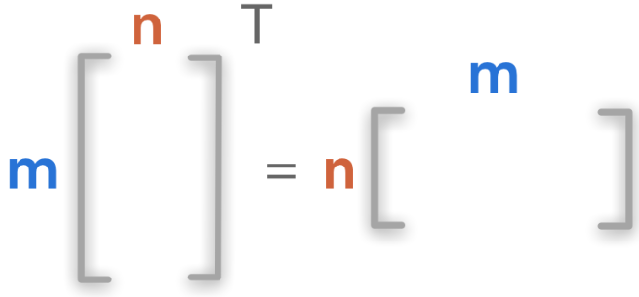
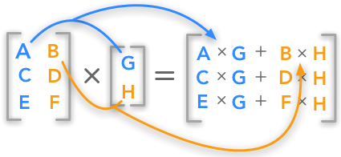
Linear algebra for Data science
Matrix Transpose
With transposition we can convert a
row vector to a column vector and vice versa.
Multiplying Matrices and Vectors
The dot product of matrices & vectors is
used in every equation explaining data
Science algorithms.
Matrices multiplication is distributive,
associative, NOT commutative, while
vector multiplication is commutative.

Slide 6
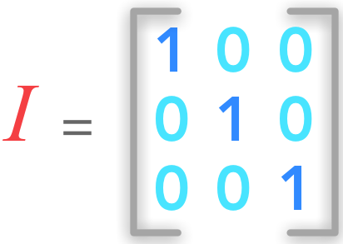

Linear algebra for Data science
Identity and Inverse Matrices
The identity matrix In is a special matrix of shape (n×n) that is filled with 0 except the diagonal that is filled with 1.
An inverse matrix is that results in the identity matrix when it is multiplied by its original form.

Slide 7
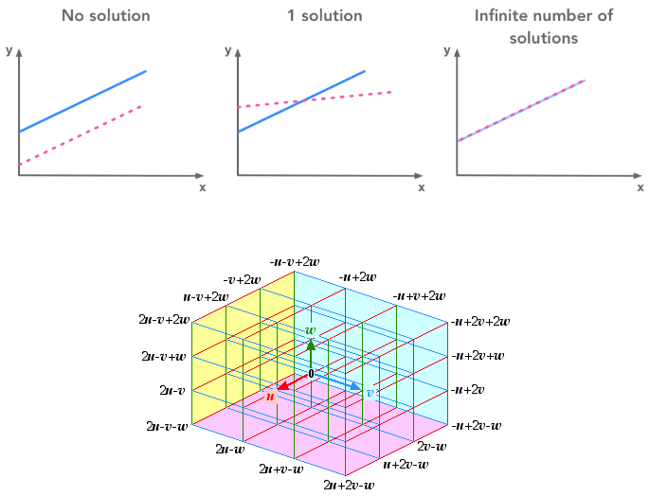
Linear algebra for Data science
Linear Dependence and Span
We cover here how to represent
systems of equations graphically,
how to interpret the number of
solutions of a system, what is
Linear combination, dependence
and span.

Slide 8
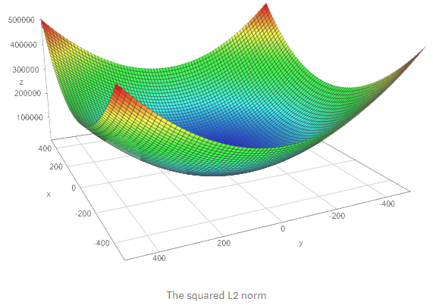
Linear algebra for Data science
Norms
The norm is what is generally used to evaluate the error of a model. For instance it is used to calculate the error between the output of a neural network and what is expected (the actual label or value)

Slide 9
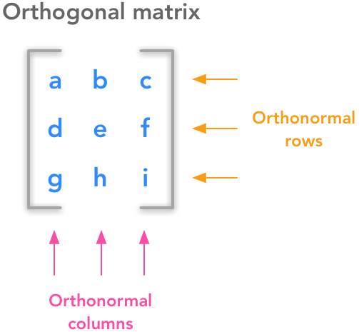
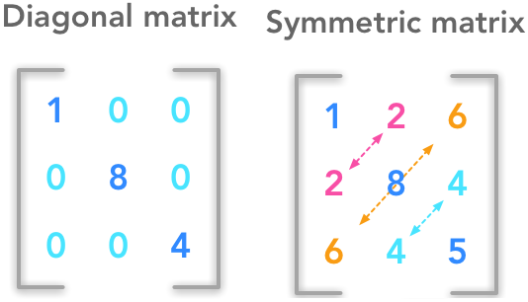
Linear algebra for Data science
Special Kinds of Matrices and Vectors
This section covers different interesting type of matrices with specific properties i.e. Diagonal, Symmetric & Orthogonal matrices.

Slide 10
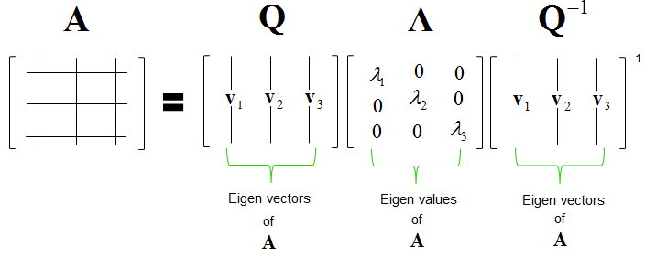
Linear algebra for Data science
Eigen decomposition
The eigen decomposition is one form of matrix decomposition. Decomposing a matrix means that we want to find a product of matrices that is equal to the initial matrix. In the case of the eigen decomposition, we decompose the initial matrix into the product of its eigenvectors and eigenvalues.
The eigen decomposition of the matrix corresponding to a quadratic equation can be used to find the minimum and maximum of that function.

Slide 11
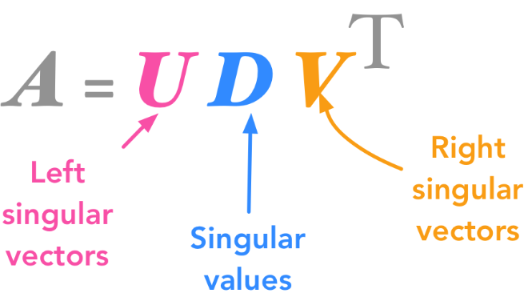
Linear algebra for Data science
Singular Value Decomposition (SVD)
The way to go to decompose other types of matrices that can’t be decomposed with eigen decomposition is to use SVD.
With the SVD, we decompose a matrix in three other matrices.
We can see these new matrices as sub-transformations of the space. Instead of doing the transformation in one movement, we decompose it in three movements.

Slide 12
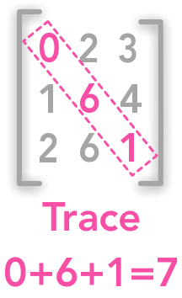
Linear algebra for Data science
The Trace Operator
The trace is the sum of all values in the diagonal of a square matrix. It can be used to specify the Frobenius norm of a matrix, which is needed for the Principal Component Analysis (PCA).

Slide 13
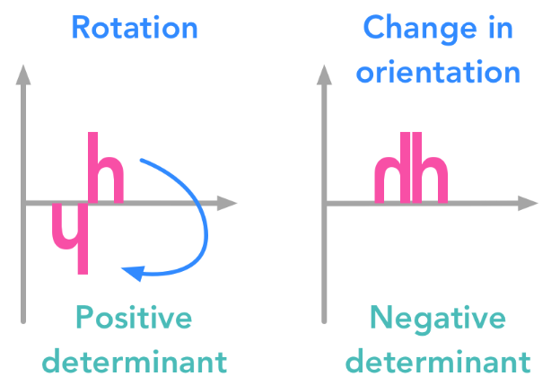
Linear algebra for Data science
The Determinant
The determinant of a matrix AA is a number corresponding to the multiplicative change you get when you transform your space with this matrix.
A negative determinant means that there is a change in orientation (and not just a rescaling and/or a rotation).

Slide 14
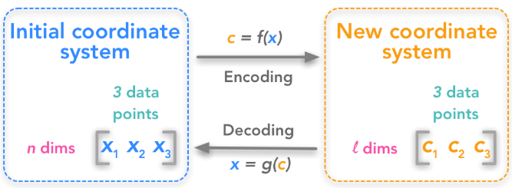
Linear algebra for Data science
Principal Component Analysis
When the data-set is high-dimensional, it would be nice to have a way to reduce these dimensions while keeping all the information present in the data-set.
The aim of principal components analysis (PCA) is generally to reduce the number of dimensions of a data-set where dimensions are not completely de-correlated.

Slide 15
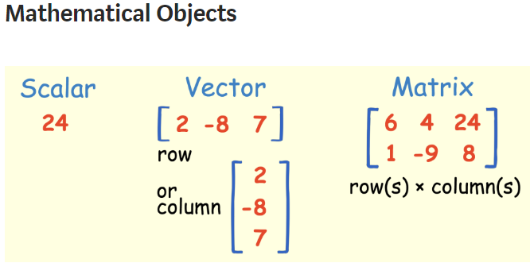
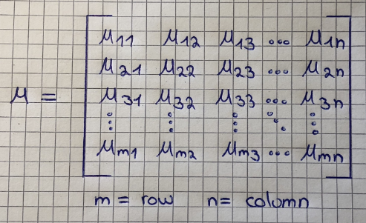
Linear algebra for Data science
Matrix

Slide 16
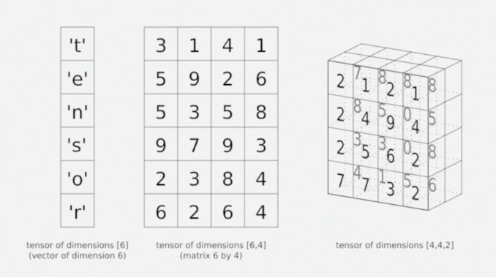
Linear algebra for Data science
Tensor
You can think of a Tensor as an array of numbers, arranged on a regular grid, with a variable number of axes.
A Tensor has three indices, where the first one points to the row, the second to the column and the third one to the axis.
For example, T332 points to the third row, the third column, and the second axis.
This refers to the value 0 in the right Tensor in the graphic below:

Slide 17
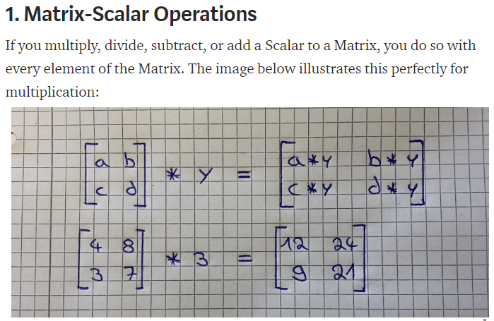
Linear algebra for Data science

Slide 18
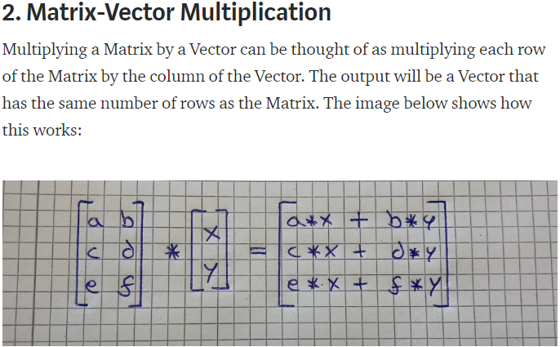
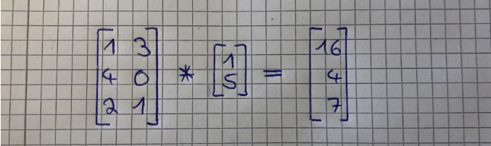
Linear algebra for Data science

Slide 19
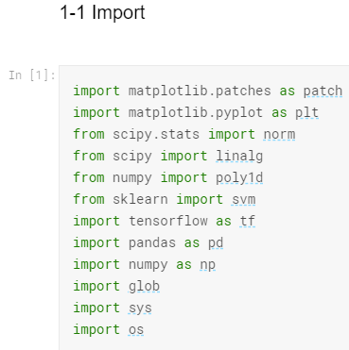
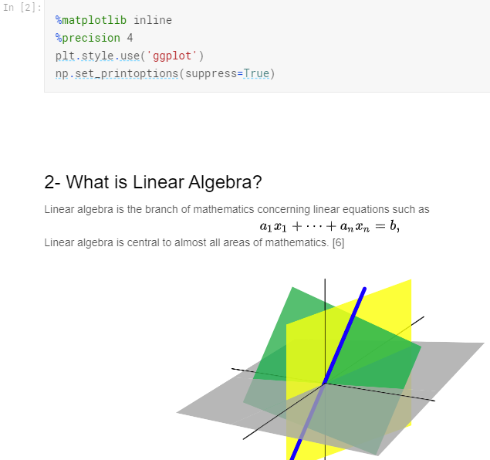
Linear algebra for Data science

Slide 20
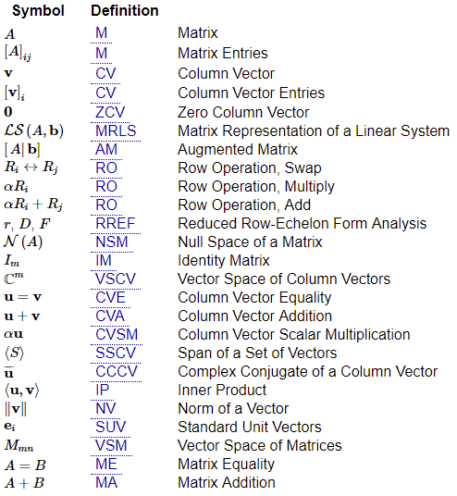
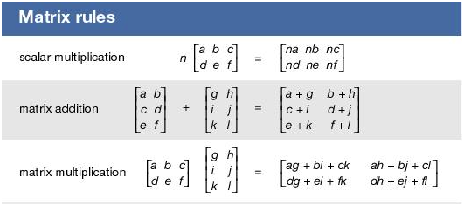
Linear algebra for Data science

Slide 21
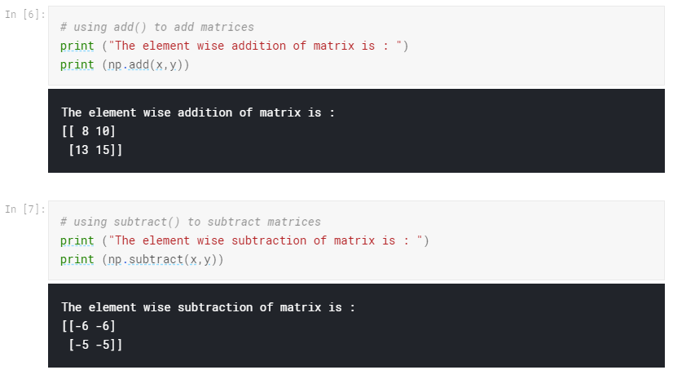
Linear algebra for Data science

Slide 22
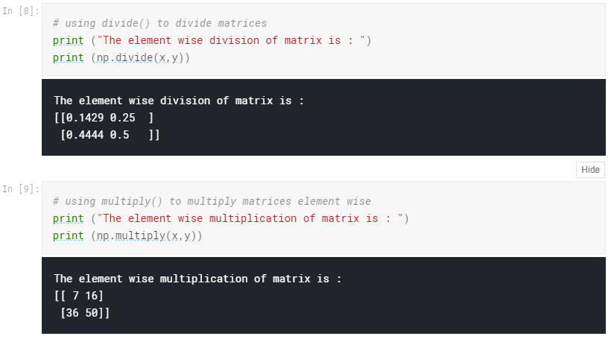
Linear algebra for Data science

Slide 23
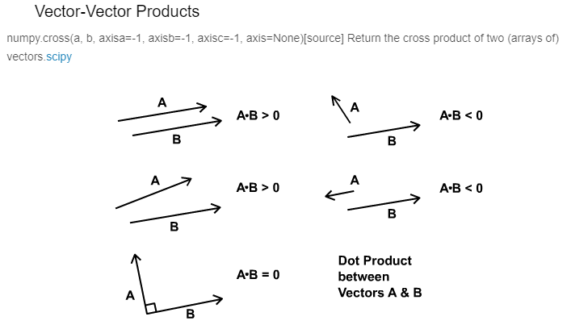
Linear algebra for Data science

Slide 24
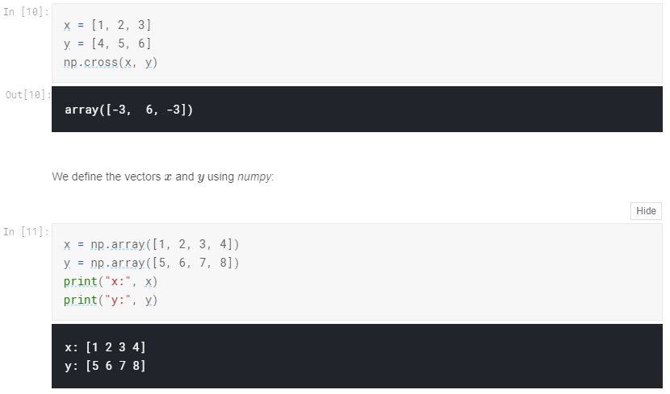
Linear algebra for Data science

Slide 25
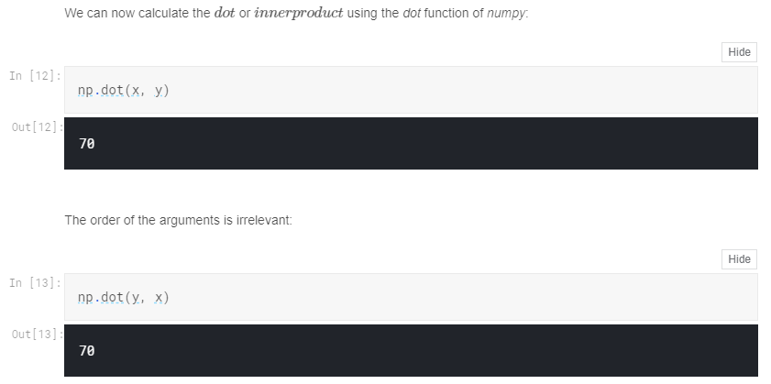
Linear algebra for Data science

Slide 26
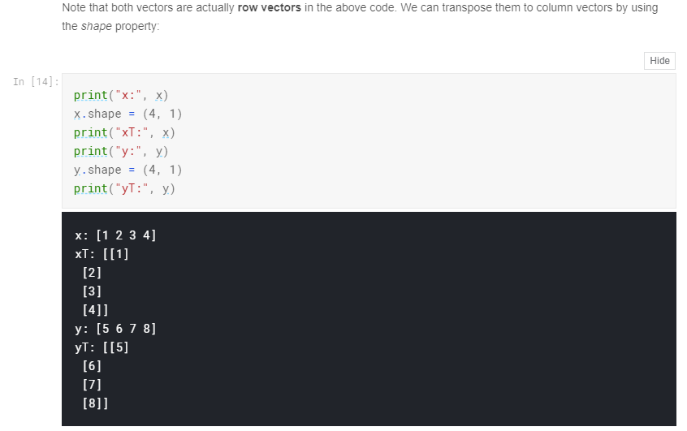
Linear algebra for Data science

Slide 27
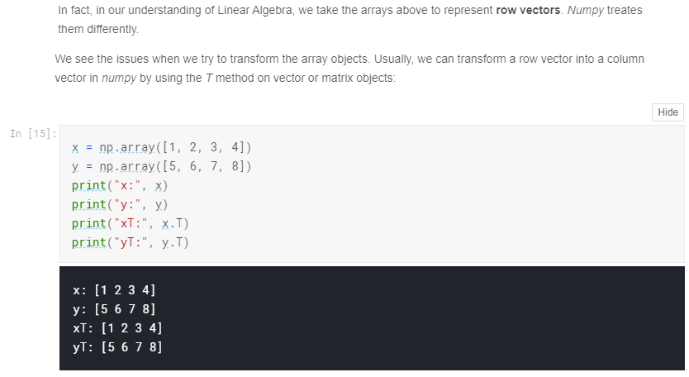
Linear algebra for Data science

Slide 28
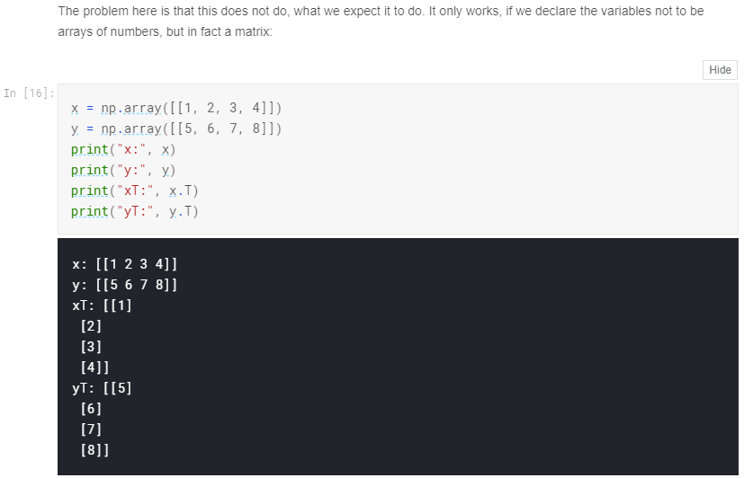
Linear algebra for Data science

Slide 29
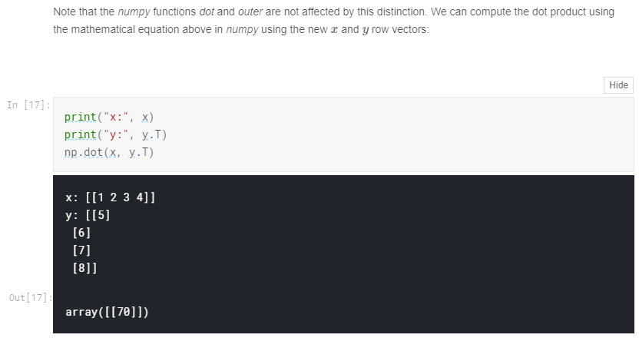
Linear algebra for Data science

Slide 30
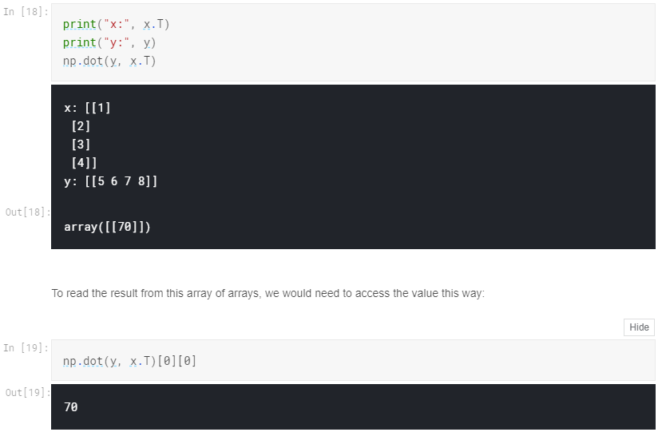
Linear algebra for Data science

Slide 31
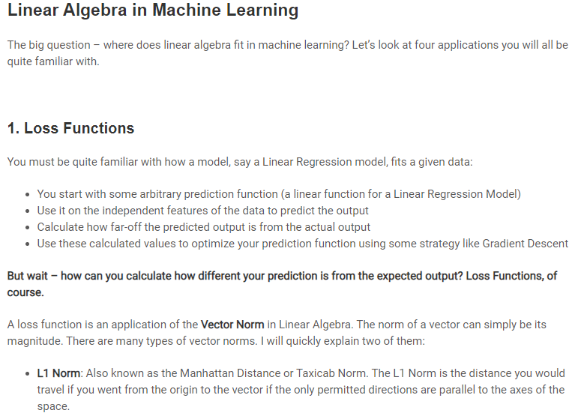
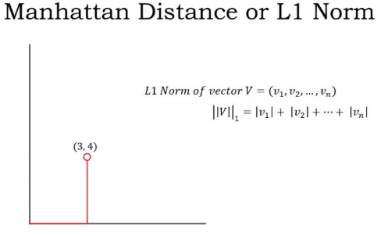
Linear algebra for machine learning

Slide 32
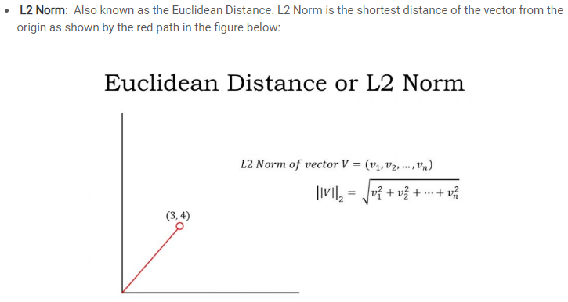
Linear algebra for machine learning

Slide 33
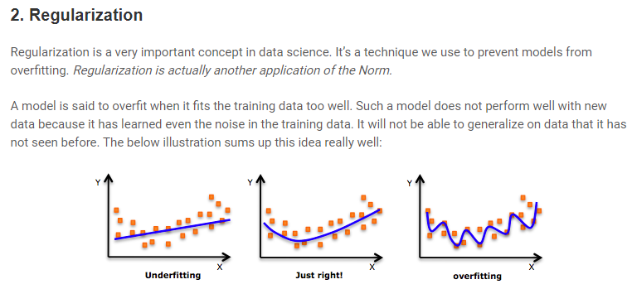
Linear algebra for machine learning

Slide 34
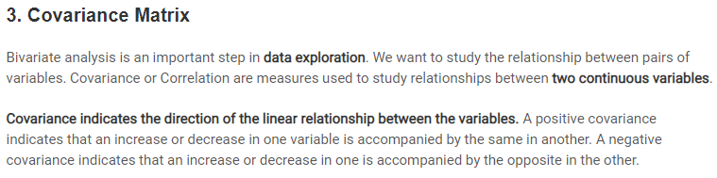
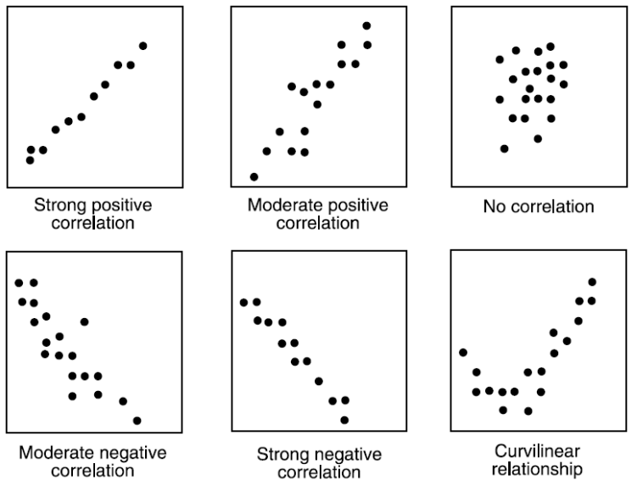
Linear algebra for machine learning

Slide 35
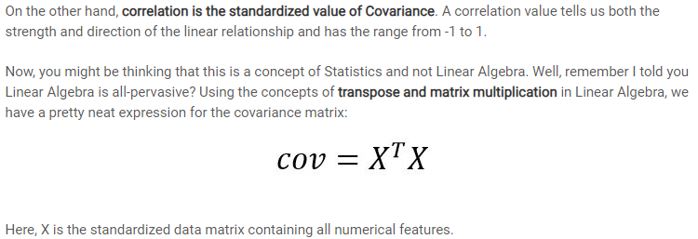
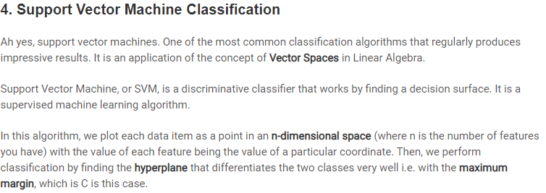
Linear algebra for machine learning
DYS
PCA
NLP

Slide 36
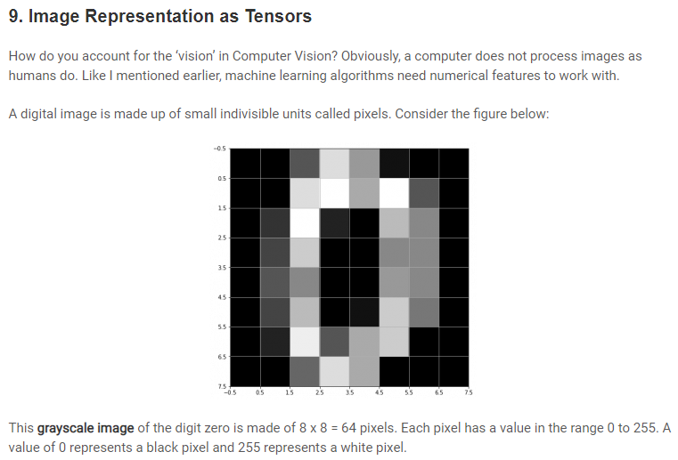
Linear algebra for machine learning

Slide 37
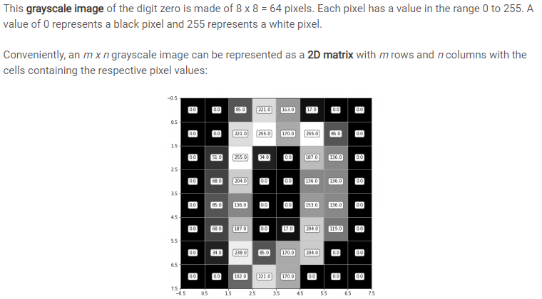
Linear algebra for machine learning

Slide 38
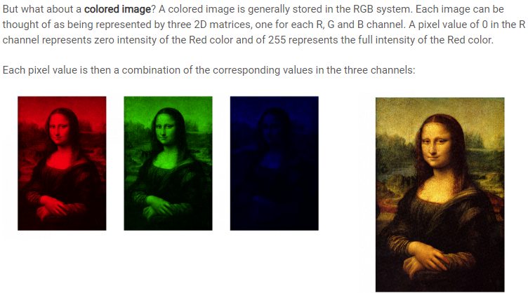
Linear algebra for machine learning

Slide 39
Linear algebra for Data science
Transformations

